Slide 1
Project 1
Topic: Using Price Correlation to Minimize Portfolio risk.
By
Osman Dumbuya
See Jupiter notebook file name “ ProjPracAug13.ipynb” in GitHub Repository address: https://github.com/odumbuya1/Project-1.git

Slide 2
1 Content:
1. Introduction. 2. Correlation and Stock portfolio Diversification. 3. Daily Stock Price Returns. 4. Two (2) Datasets of Stocks Considered 5. Plot Cumulative Stock Returns 6. Heatmaps 7. Conclusion

Slide 3
Content: 1. Data source: yfinance 2. 10 Stocks Considered 3. Meaning of Correlation Coefficient 4. Daily price returns computed 5. Cumulative Price Returns show stock performance
Correlation Matrix for 10 stocks created and analyzed
Plot Scatter diagram for correlation matrix
Conclusion.

Slide 4
Introduction: The project’s goal is to build a well diversified portfolio that minimizes risk. Portfolio risk is simply defined to be the loss associated with fall in stock prices. The project shows that that risk is much greater in a non diversified portfolio with high correlated stocks. While the loss in a diversified stock portfolio may be minimized, if stocks had low or zero correlation. Key factors that may trigger a fall in stock price have their roots in economic, and or financial markets instabilities for example increases in interest rates, increases in market uncertainties, stock market decline or crashes and deterioration in bank balance sheets. Regardless of the source of stock price decline, the project advances a first line of defense to minimize stock price portfolio losses.

Slide 5
Introduction(contd.)
The project’s hypothesis states ” a fall in stock prices given a diversified portfolio minimize losses relative to a non-diversified portfolio.
Two (2) datasets were collected from Yahoo Finance:
10 companies selected from within the technology industry; and another 10 companies selected from diverse sectors (including technology, automotive, pharmaceuticals, finance, home improvement and oil and gas.
The dataset covers a period of 5 years starting Jan 2019 to Jan 2024. Pandas, NumPy, matplotlib, seaborn , datetime were used and data was imported from Yahoo finance. In the next section, the meaning of correlation is explained.

Slide 6
Correlation and Stock Portfolio Diversification
A correlation statistic measures how closely two or more variable move together, either in the same direction, or in opposite directions or if they are related at all. The Pearson correlation coefficient ranges between -1 <= 0 <= 1.
Correlation Coefficient = 1 When the correlation coefficient = 1 or (corr = 1); means there is a positive, very strong same directional movement or relationship between two or more variables. Assume a stock portfolio exhibits stock prices, which are highly correlated, it implies if prices are in a downward trend, the correlated stock prices will equally decline, and implies a bigger loss.

Slide 7
Correlation Coefficient = 0
When corr = 0, implies price movements of stocks in a portfolio are not related. So, while a particular stock price may fall, has no effect on another stock in the same portfolio. In a well diversified stock portfolio, with low or zero stock price correlation, price movement are independent of each other so a decline in price of a stock may only affect a single stock or hence losses or risks are minimized. The other extreme is when correlation coefficient = -1(corr = -1) it means there is opposite price relationship among stocks.
In the next section, the study examines the concept of “daily stock price returns” computed as gains or losses from the effect of price changes.

Slide 8
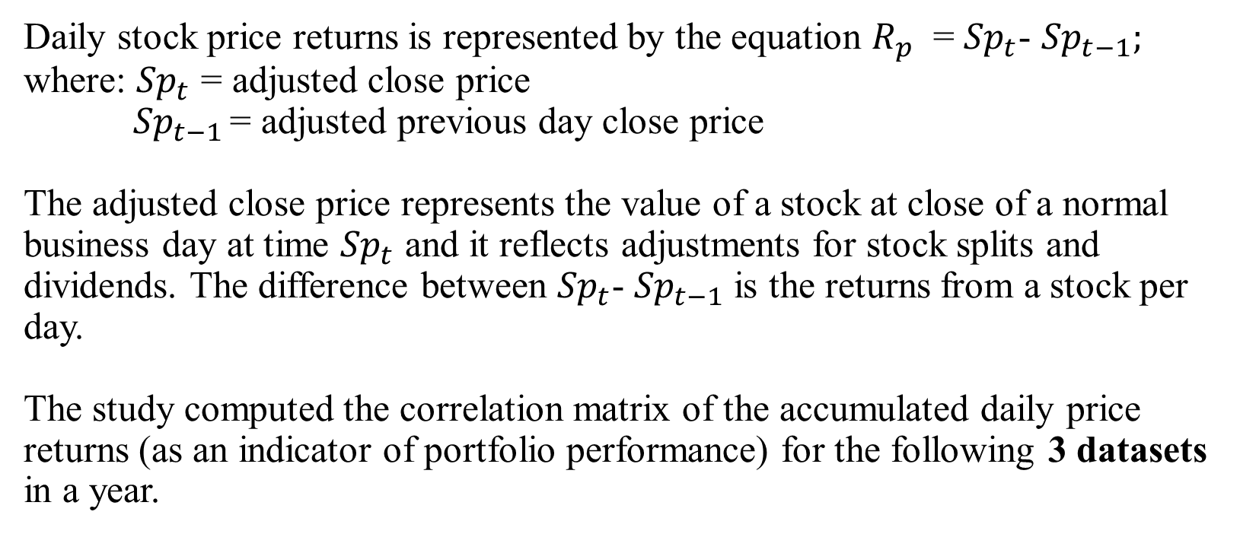
Daily Stock Price Returns
Daily stock price returns is represented by the equation $R_{p}$ = ${Sp}_{t}$- ${Sp}_{t−1};$ where: ${Sp}_{t}$ = adjusted close price ${ Sp}_{t−1 }$= adjusted previous day close price The adjusted close price represents the value of a stock at close of a normal business day at time ${Sp}_{t}$ and it reflects adjustments for stock splits and dividends. The difference between ${Sp}_{t}$- ${Sp}_{t−1}$is the returns from a stock per day. The study computed the correlation matrix of the accumulated daily price returns (as an indicator of portfolio performance) for the following 3 datasets in a year.

Slide 9
The Two (2) Datasets of Stocks Considered (see Page 15)
Dataset 1: ("TSLA","AAPL","AMZN","HD","PFE","JNJ","F","BAC","XOM","KO“); 10 stocks from semiconductor technology companies are considered as a non-diversified portfolio of stocks because all 10 are from the same industry. TSLA showed a leading performance in term of higher price returns this industry. See plot of cumulative price returns below:
Dataset 2: ["MSFT", "GOOG", "AAPL", "HPE", "CRM", "COP", "PSX", "OXY", "XOM", "CVX"] This portfolio consist of 5 Information technology companies and another 5 companies from oil and gas industry. See plot of cumulative price returns below. The plot shows that Apple Inc. (APPL) and Microsoft(MSFT) stock price returns were the highest while price returns for oil companies were relatively lower.

Slide 10
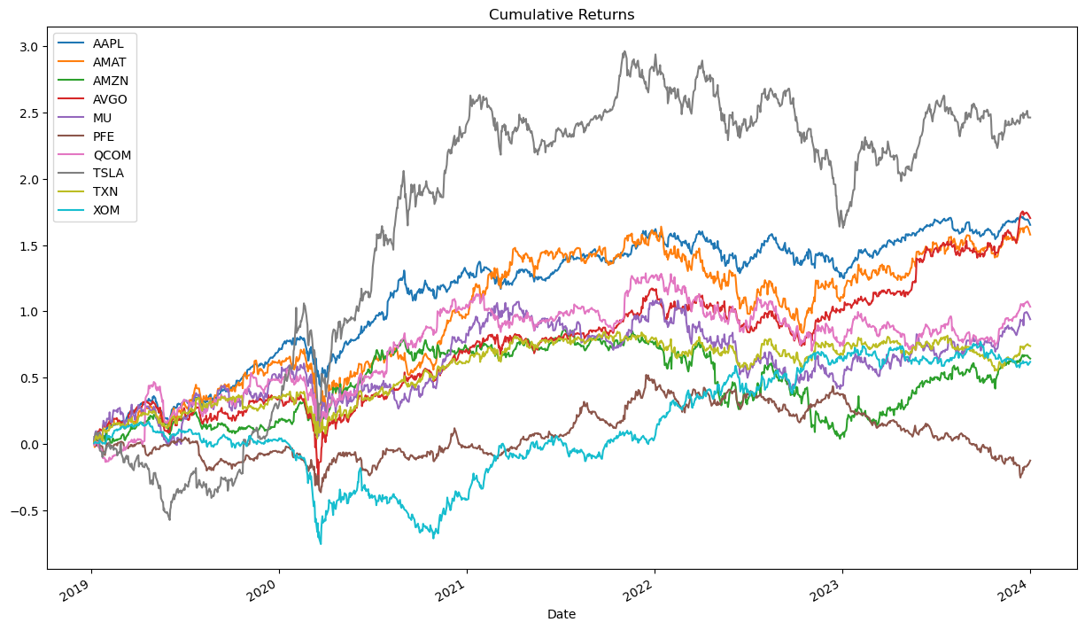

Slide 11
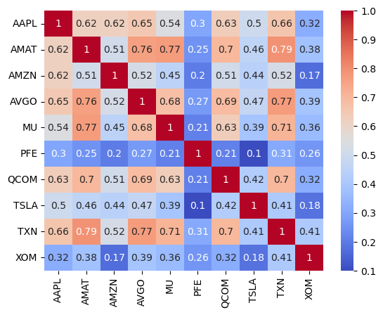
Heatmap (Dataset1) The heatmap to the left is price correlation matrix for this dataset or portfolio. It shows very strong correlation to a high of 0.79 between the price of Applied Materials Inc(AMAT) stocks and Texas Instrument (TXN). More than half of 10 stocks are high correlated. As shown for AMZN, TXN, AVGO and MU. Hence a turmoil in semiconductor technology industry will significantly affect this portfolio.

Slide 12
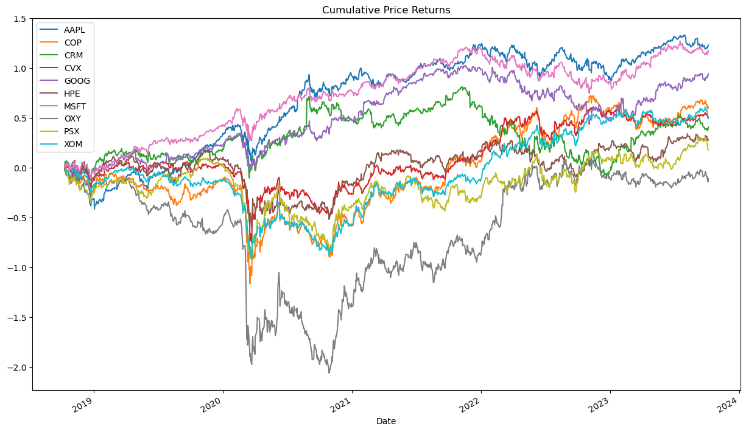

Slide 13
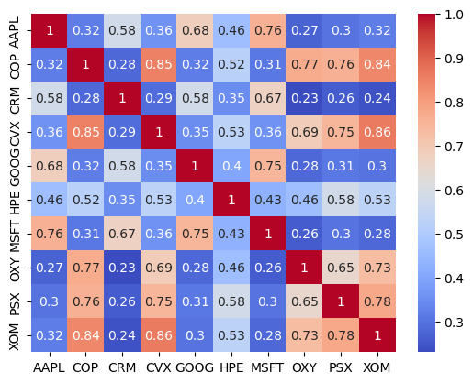
Dataset2 The heatmap reveals weak correlation across information technology companies to oil and gas companies. For example, APPL has weak correlation with Exxon Mobile (XOM), Occidental Petroleum (OXY) and Phillips 66(PSX). It is also evident that there is a strong correlation between the price returns for oil and gas companies within the same industry. The price of Chevron Corporation (CVX) showed a strong price correlation with Occidental Petroleum (OXY), Philips 66 and Exxon Mobile (XOM). This portfolio may not be most ideal for risk minimization.

Slide 14
Conclusion
The use of correlation to filter for risk minimization is necessary condition but needs to be accompanied with tools to increase safe and high returns as well. Secondly, building and managing a stock portfolio with minimized or zero risk environment is of keen interest to my career aspirations. The search for high return and well diversified stocks with weak or low correlation coefficient has just started.

Slide 15
Datasets Tickers Define
 | Dataset1 |  | Dataset2
1. | Tesla Inc. | TSLA | Microsoft Corporation | MSFT
2. | Apple Inc. | AAPL | Alphabet Inc | GOOG
3. | Amazon.com | AMZN | Apple Inc | AAPL
4. | Texas instrument | TXN | Hewlett Packard Ent. | HPE
5. | Pfizer Inc | PFE | Salesforce, Inc | CRM
6. | Qualcomm Inc | QCOM | ConocoPhillips | COP
7. | Broadcom Inc | AVGO | Phillips 66 | PSX
8. | Micro Technology | MU | Occidental petroleum | OXY
9. | Exxon Mobile | XOM | Exxon Mobile | XOM
10 | Applied materials Inc | AMAT | Chevron Corporation | CVX

